Slide 1


Slide 2
Sports Data Analysis

Slide 3
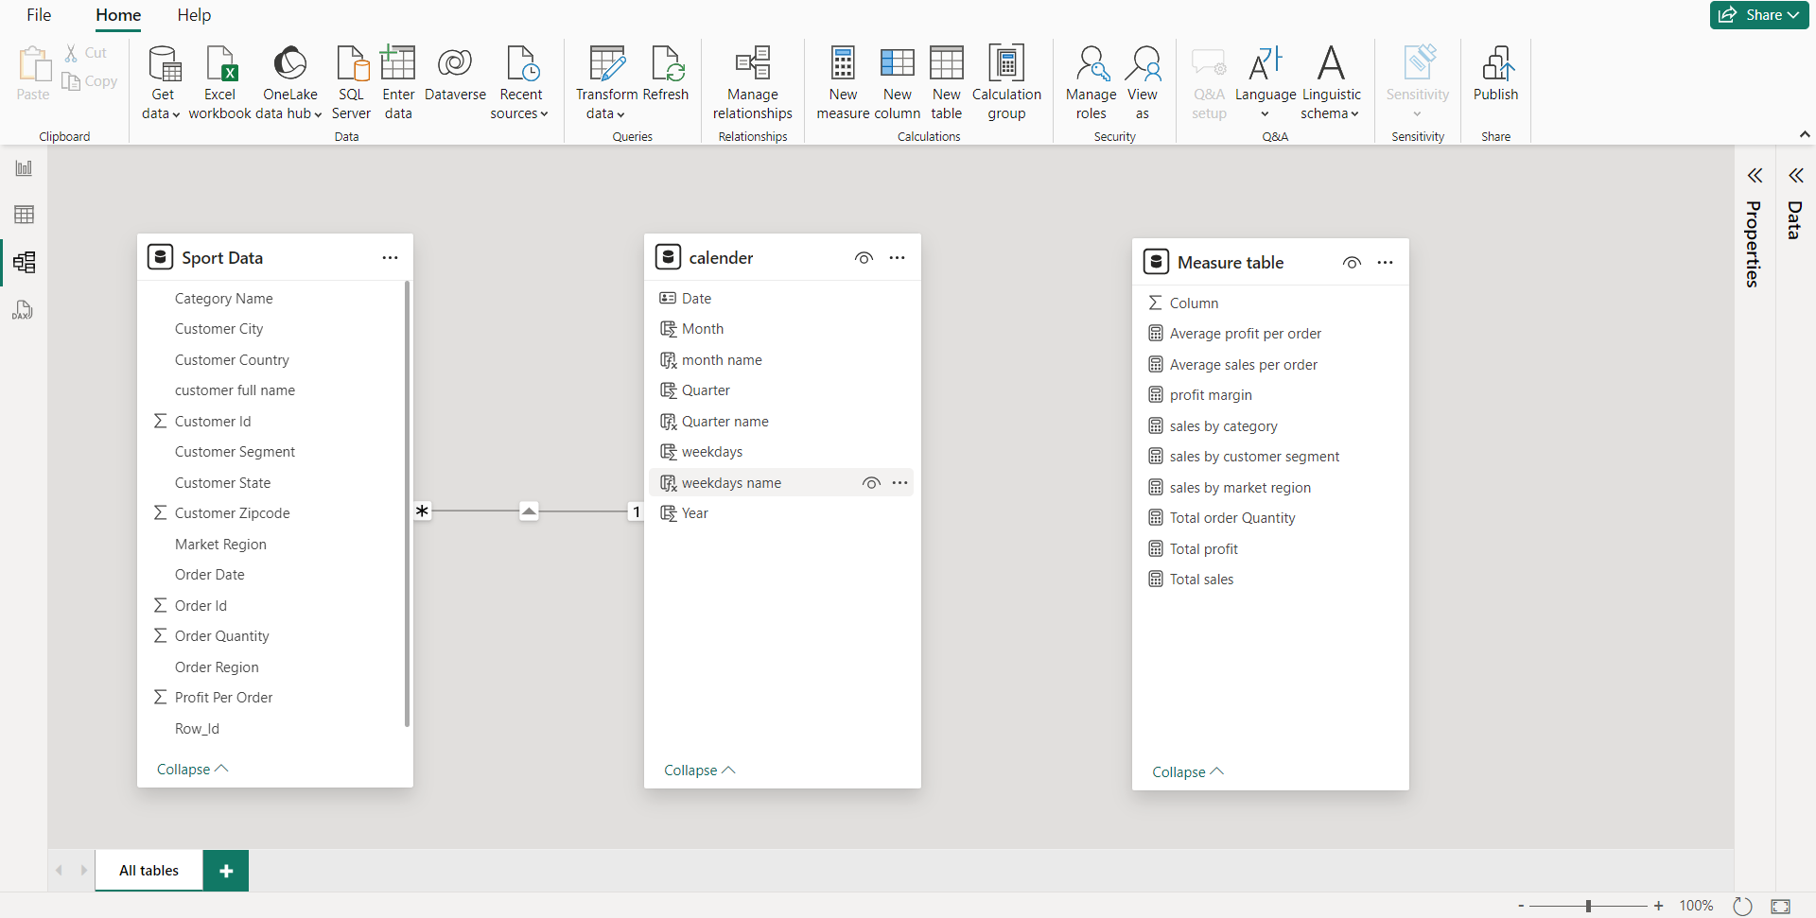
Data Relationship

Slide 4
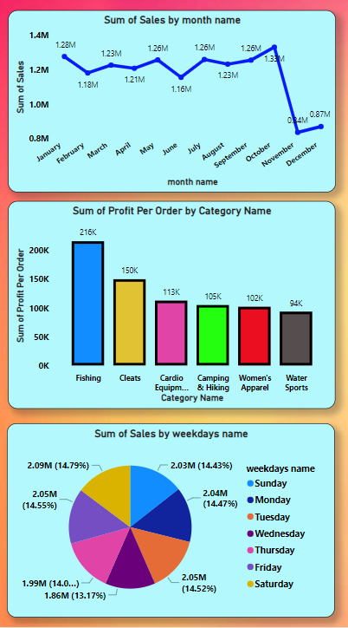
Overview - Sport Analysis
We can analysis sport data in a variety of ways. This line chart can display the sum of sales by month name. Between November and December, we see that sales will fall and the line will move downward.
To analysing this Bar graph it can show the total sum of profit per order by category name wise and Fishing is the category name which can show the highest sum of profit per order.
In this Pie Chart we can analyse the Total sum of sales by Weekdays name wise. It can give you the perfect data of percentage(%) wise. It show that highest sales of weekday that is Saturday.

Slide 5
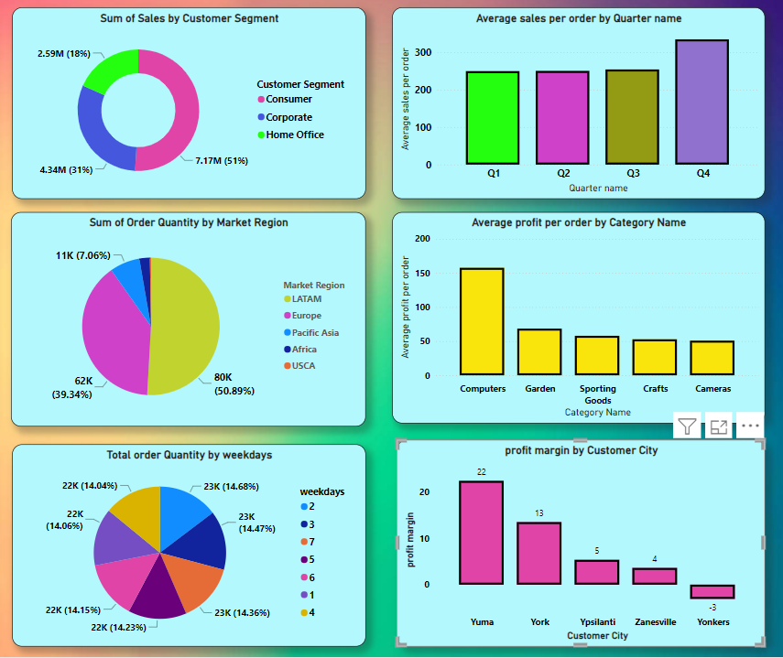
Below Pie charts and Bar graphs can show the Total sales by customer segment,Order quenty by market region,Total orders by weekdays average sales per order,average profit of orders and customer city wise profit Margin Accordingaly.

Slide 6
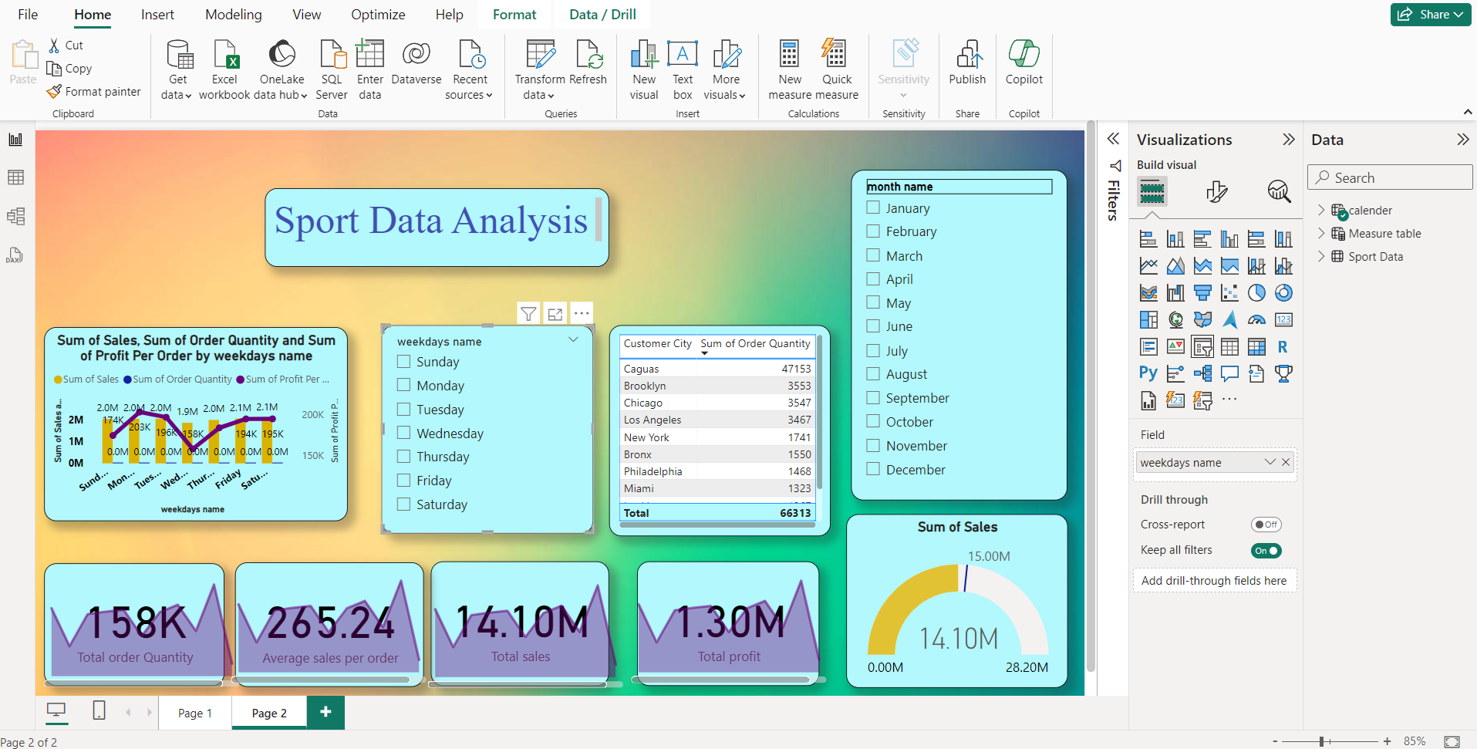

Slide 7
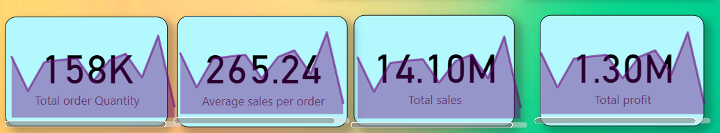
Analysis
Total Order Quantity
Of Sports Data
Is 158k.
Average sales per order of the Sport data is 265.24 rs.
Total sales of the Sport Data is 14.10M accurately.
Total profit of the sports data is 1.30M.

Slide 8
Conclusion
The sports data analysis project using Power BI our company have achive total sales of $ 14.10 million .
In the month of October and Jaunary the sale is more and in November and December we can see that the the sale is low
In weekdays we can see that the sale is balanced but at Tuesday and Saturday the sale is more.
By category name we can say that the fishing and cleats have more profit order
This year we were having the target of $15 million but unfortunatly we have not reached it ue to less and less profit
The consumers have more sale in the field of coustmer segment.

Slide 9
Thank You

